Slide 1

Putting users first
The story of GOV.UK
Sarah Prag
(Ex)Government Digital Service
(ex)GDS
*
Notes:
*

Slide 2
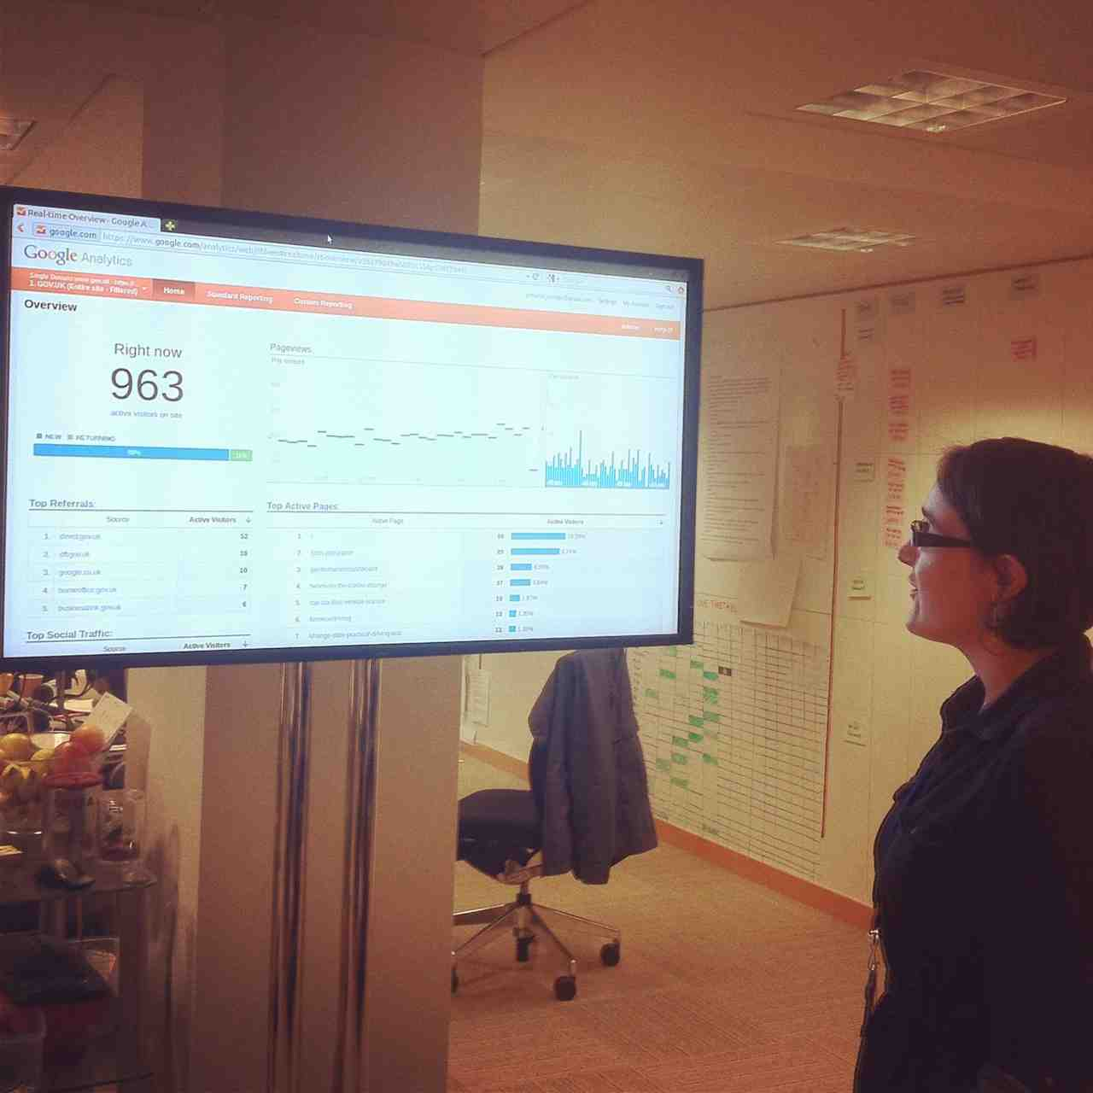
Who am I?
Sarah
(ex)GDS
GDS
Paul
*
*

Slide 3
What I’ll cover:
Brief history of GDS & GOV.UK
Starting with user needs
Evidence & data
Creating content
User journeys
Continuous improvement
Sarah
(ex)GDS
GDS
Paul
*
*

Slide 4

A very brief intro to GDS and GOV.UK
Fix publishing
Fix transactions
Go wholesale
Sarah
(ex)GDS
GDS
Paul
*
*
Notes:
October 2010 Directgov 2010 and beyond: revolution not evolution’

Slide 5
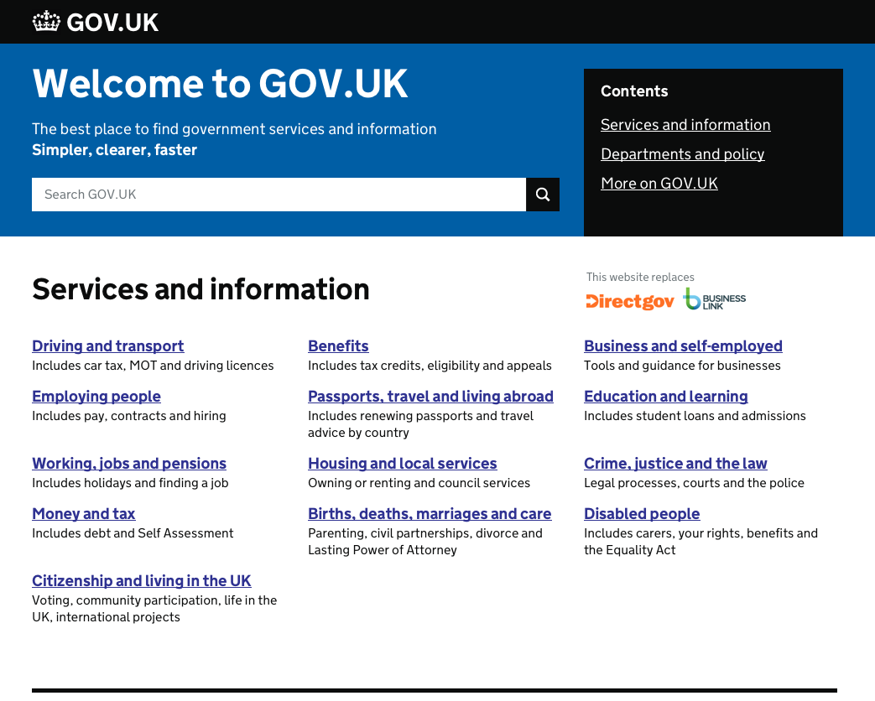
Sarah
GDS
GDS
Paul
*
*
Notes:
GOV.UK = publishing
Replaced DirectGov & BL

Slide 6
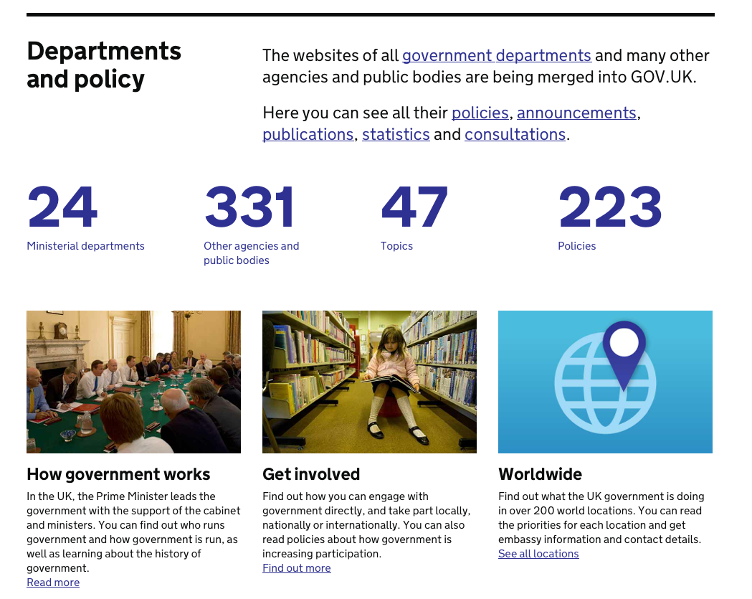
Sarah
GDS
GDS
Paul
*
*
Notes:
Replaced 24 depts, others in progress

Slide 7
Simpler
Clearer
Faster
Sarah
(ex)GDS
GDS
Paul
*

Slide 8
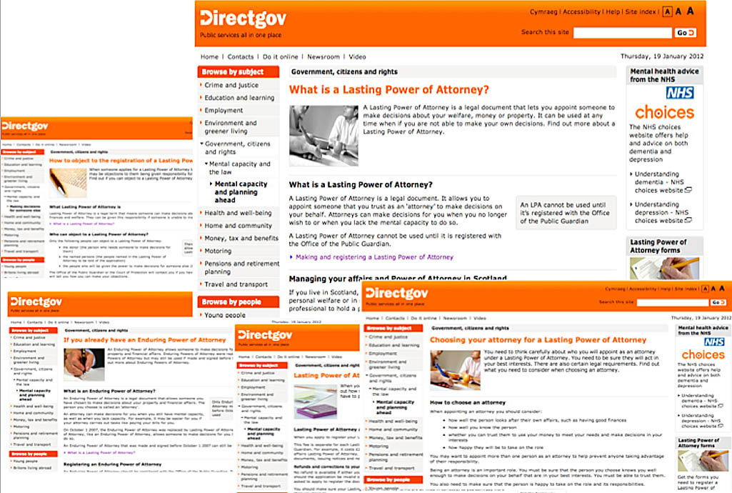
Sarah
(ex)GDS
GDS
Paul
*
*

Slide 9
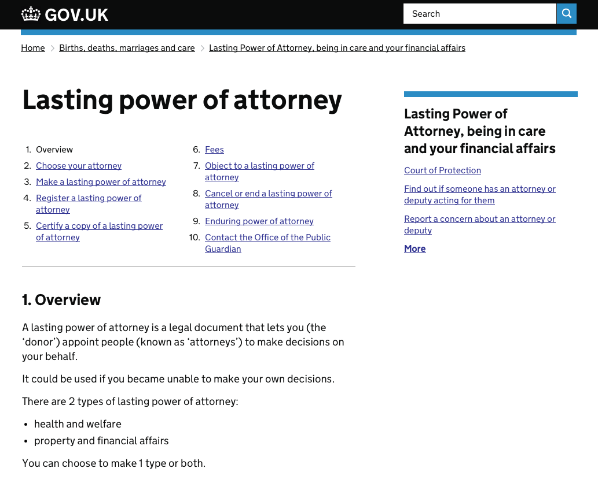
Sarah
(ex)GDS
GDS
Paul
*
*

Slide 10
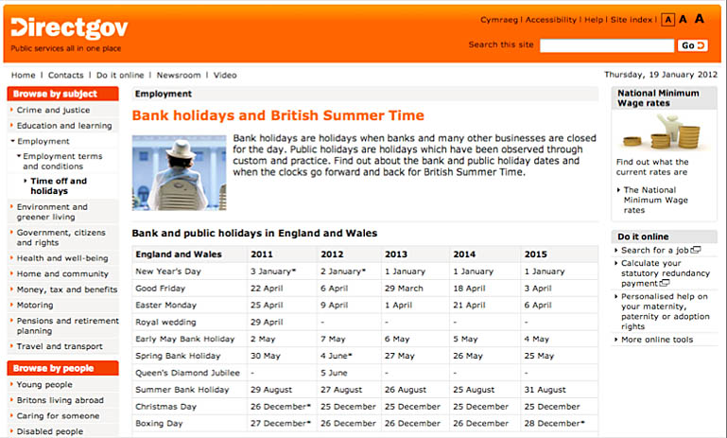
Sarah
(ex)GDS
GDS
Paul
*
*

Slide 11
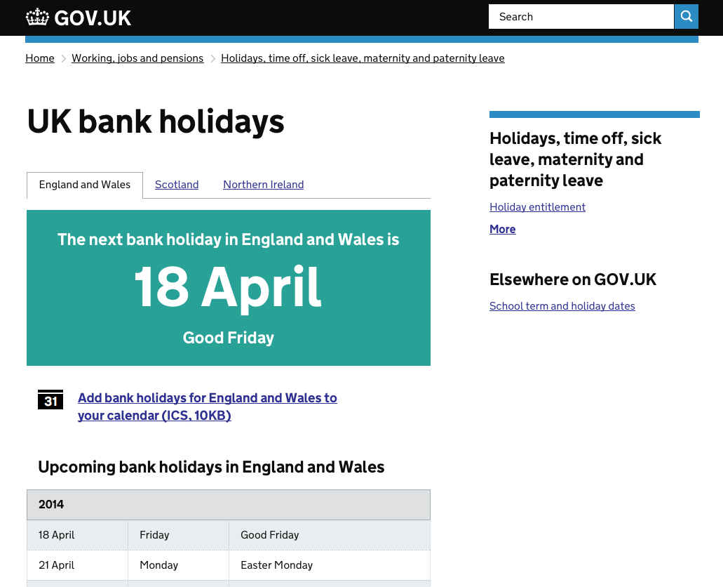
Sarah
(ex)GDS
GDS
Paul
*
*

Slide 12
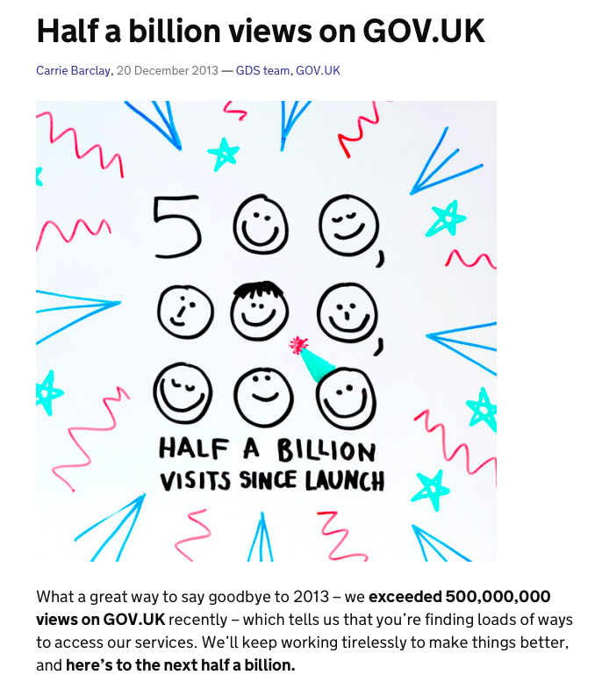
It’s big…
Sarah
(ex)GDS
GDS
Paul
*

Slide 13
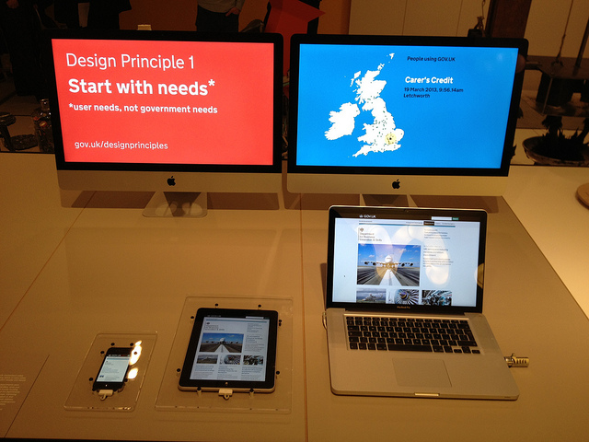

It’s won things…
Design of the Year
2013
D&Ad Awards
2013
Sarah
(ex)GDS
GDS
Paul
*
*
Notes:
D&Ad (D and A D) - Writing for Design / Writing for Websites & Digital Design

Slide 14
It’s saved some money…
£42 million
In 2012/13
Sarah
(ex)GDS
GDS
Paul
*
*
Notes:
£42m saved in 2012/13 by bringing Directgov and BusinessLink websites onto GOV.UK. It cost £7.9m to run Directgov and BusinessLink in 2012/13 before the content was moved to GOV.UK. (Government Digital Strategy Quarterly Progress Report July 2013)

Slide 15
It’s all down to understanding user needs
Sarah
(ex)GDS
GDS
Paul
*
*

Slide 16
User needs
Sarah
(ex)GDS
GDS
Paul
*
*

Slide 17
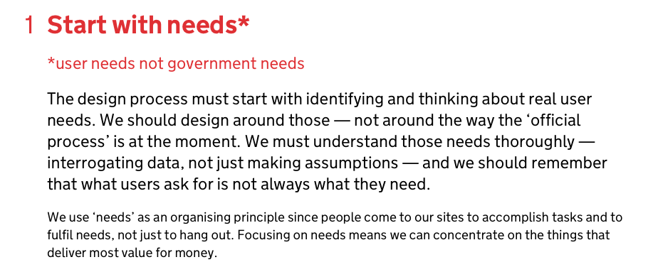
Sarah
(ex)GDS
GDS
Paul
*
*

Slide 18
What are real people looking for?
How can you best meet that need?
Efficient for them… and for you
Sarah
(ex)GDS
GDS
Paul
*
*

Slide 19
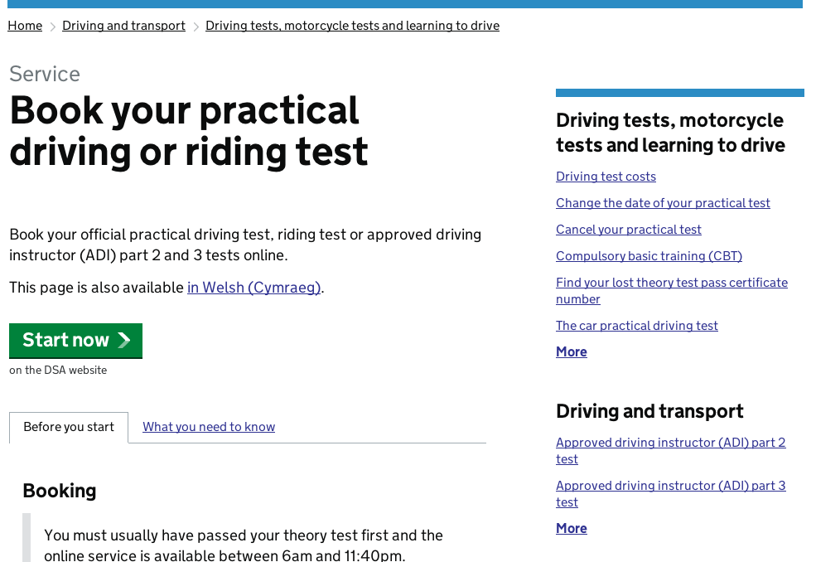
Post: £6.62
Phone: £4.11
Online: £0.22
Sarah
(ex)GDS
GDS
Paul
*
*
Notes:
20x cheaper than phone
30x cheaper than post
50x cheaper than face-to-face

Slide 20
Evidence
Sarah
(ex)GDS
GDS
Paul
*
*

Slide 21
Data from
existing sites
Google & other online tools
your call centre & other channels
Sarah
(ex)GDS
GDS
Paul
*
*

Slide 22
Helps you to
identify your priorities
fight your battles
choose the right language to use
Sarah
(ex)GDS
GDS
Paul
*
*
Notes:
GOV.UK – started with the 500 most in demand needs, then worked out way through over 2,000.

Slide 23
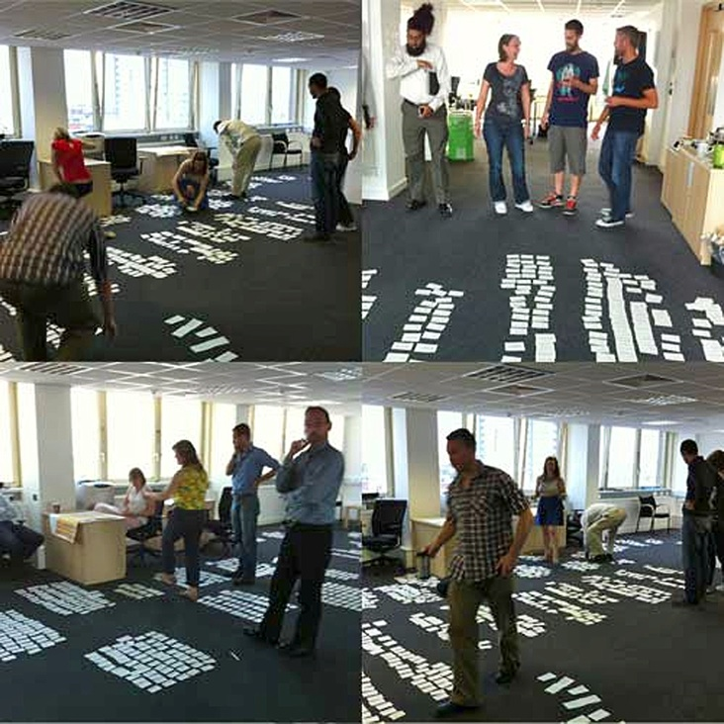
Sarah
(ex)GDS
GDS
Paul
*
*
Notes:
Identifying priority user needs based on the mass of data from DirectGov and Google

Slide 24
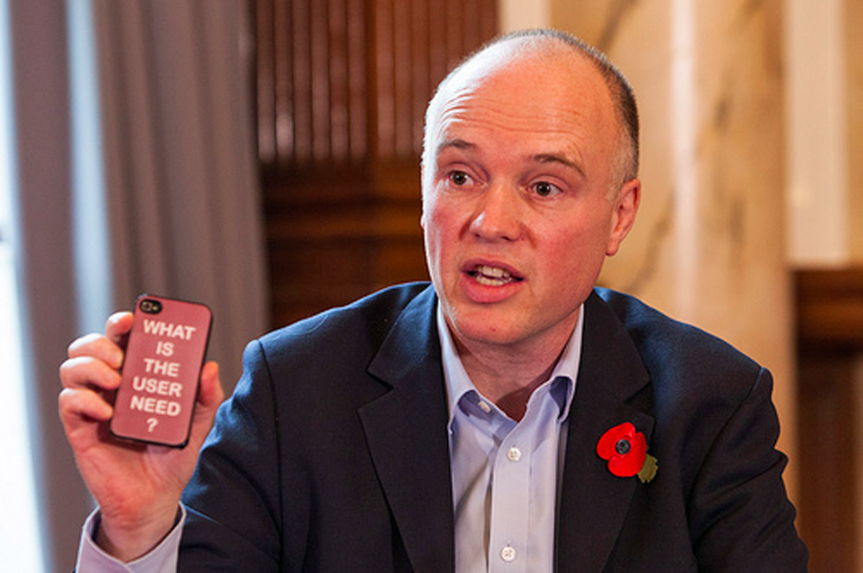
Sarah
(ex)GDS
GDS
Paul
*
*
Notes:
Fighting battles!

Slide 25
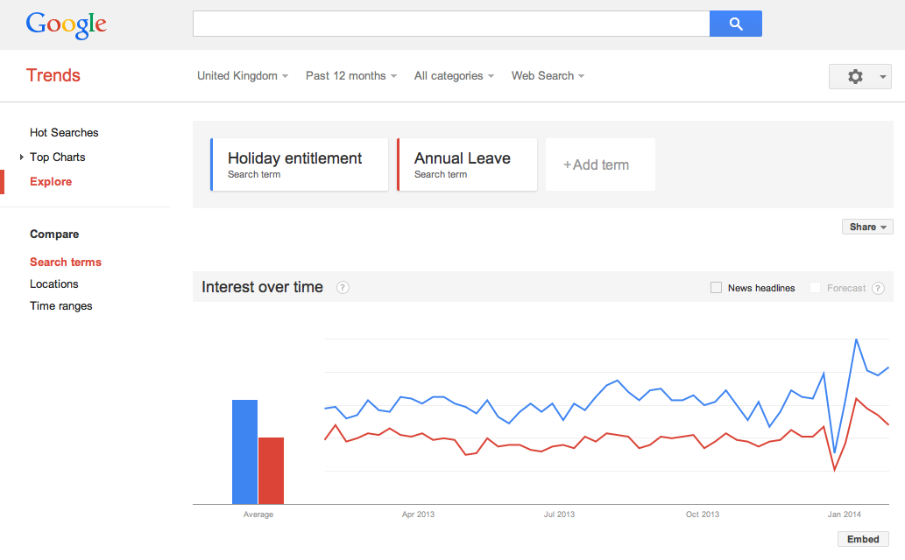
Sarah
(ex)GDS
GDS
Paul
*
*
Notes:
What language should you be using

Slide 26
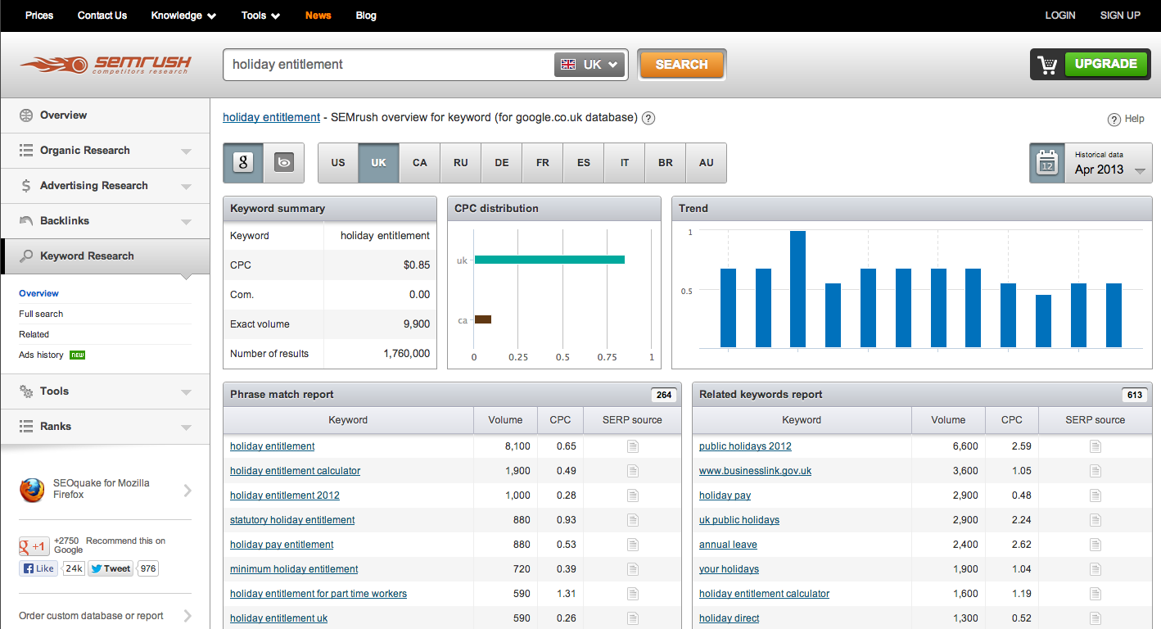
Sarah
(ex)GDS
GDS
Paul
*
*
Notes:
£40 per month
Google Adwords

Slide 27

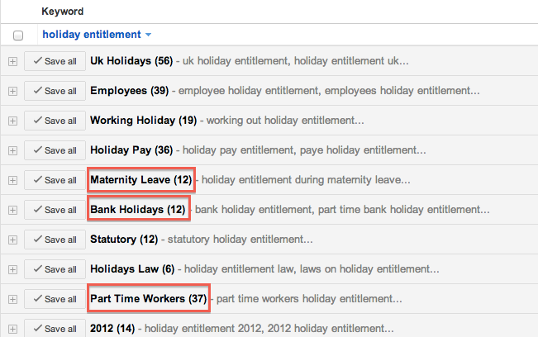
Sarah
(ex)GDS
GDS
Paul
*
*

Slide 28
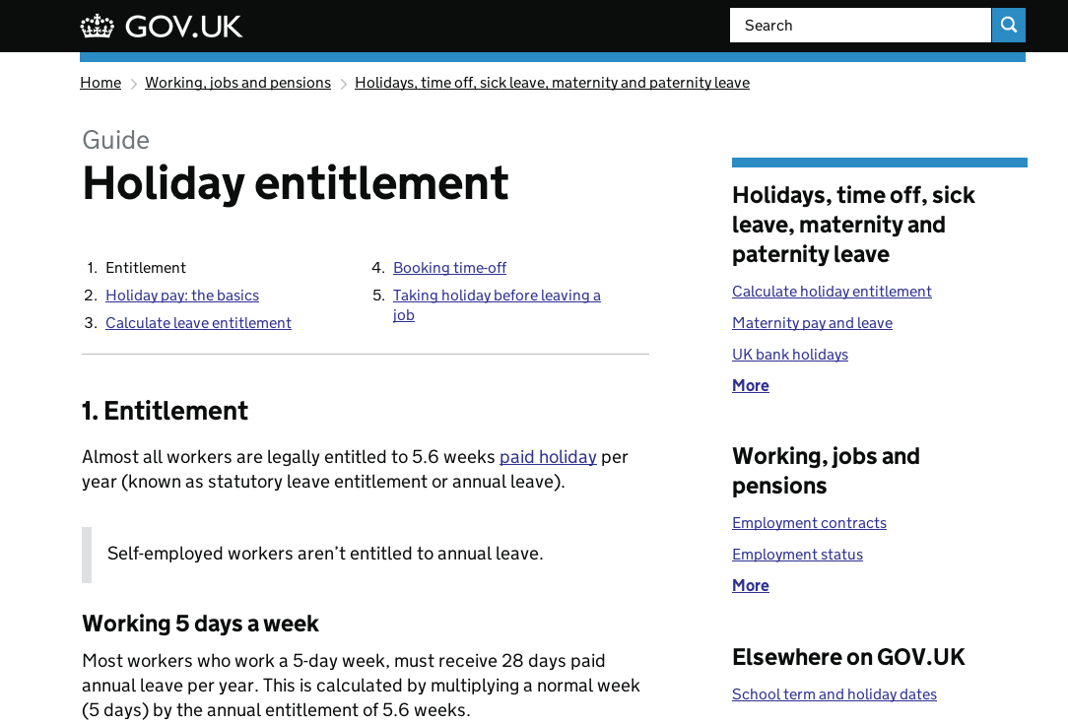
Sarah
(ex)GDS
GDS
Paul
*
*
Notes:
You’ve identified your priority needs, now you need to write good user stories

Slide 29
User stories
Sarah
(ex)GDS
GDS
Paul
*
*
Notes:
You’ve identified your priority needs, now you need to write good user stories

Slide 30
Who’s the audience?
What’s the action?
Why do they want to do it?
Sarah
(ex)GDS
GDS
Paul
*
*

Slide 31
“As a _______
I want to ________
so that I can ________”
Sarah
(ex)GDS
GDS
Paul
*
*

Slide 32
“As a self-employed person
I want to file my tax return
so that I can avoid nasty fines.”
Sarah
(ex)GDS
GDS
Paul
*
*

Slide 33
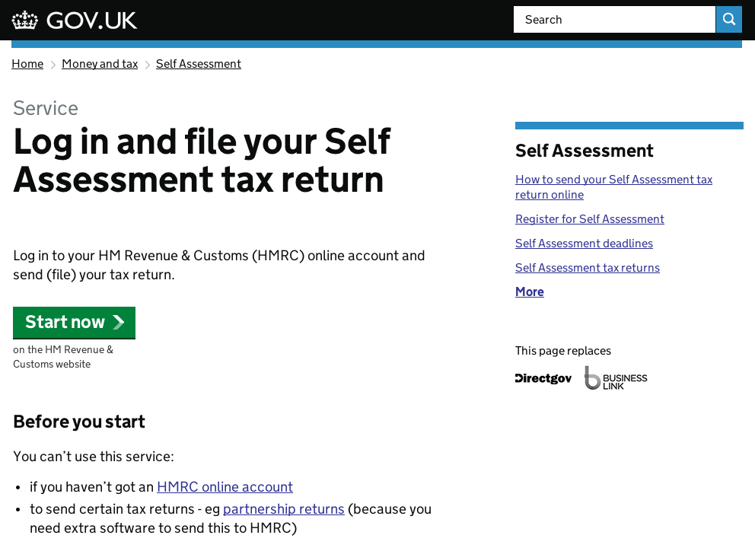
Sarah
(ex)GDS
GDS
Paul
*
*
Notes:
This is the piece of content on GOV.UK which meets that specific need.
Note – it’s not meeting the need “I need to find out if I have to do a tax return” or “I need to set myself up to do a tax return” or “I need to know the deadline…” etc
This is a focused piece of content to meet a specific need. Other related bits of content that meet some of those other needs are linked to on the right.
Come back to this later when we talk about journeys?

Slide 34
Designing content
Sarah
(ex)GDS
GDS
Paul
*
*
Notes:
Actually “content design” – more than just writing. Content designers not editors

Slide 35
Formats
Sarah
(ex)GDS
GDS
Paul
*
Notes:
We had the luxury of being able to develop new content formats for GOV.UK,
Which format is right for this need?

Slide 36
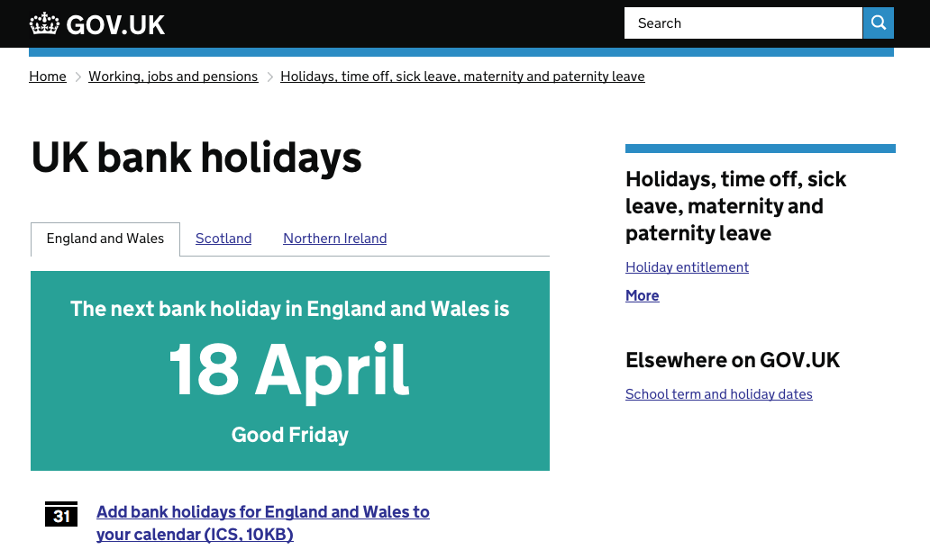
Answer
Sarah
(ex)GDS
GDS
Paul
*

Slide 37
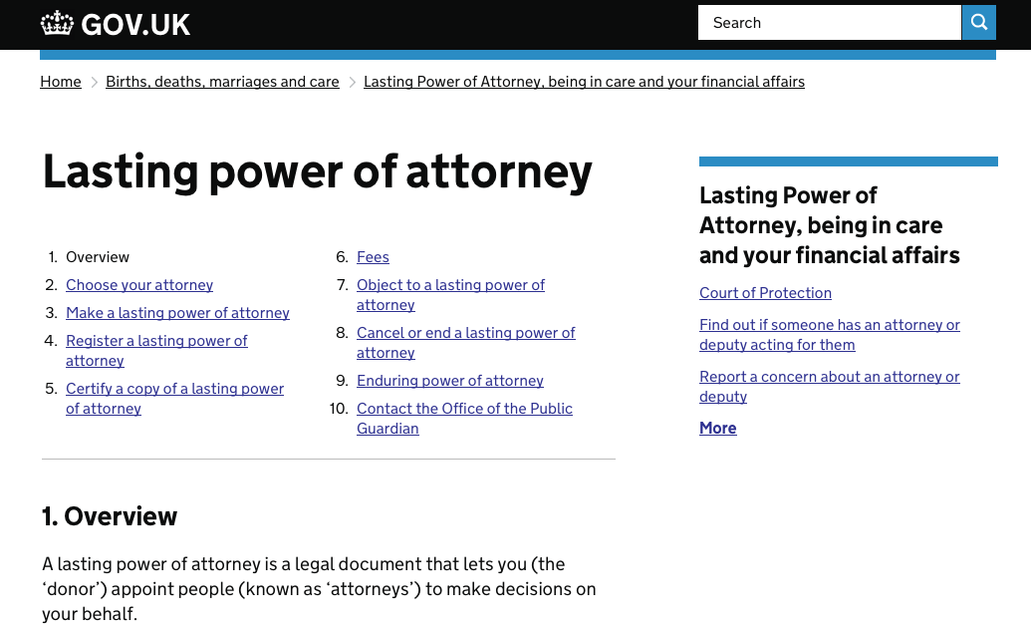
Guide
Sarah
(ex)GDS
GDS
Paul
*

Slide 38
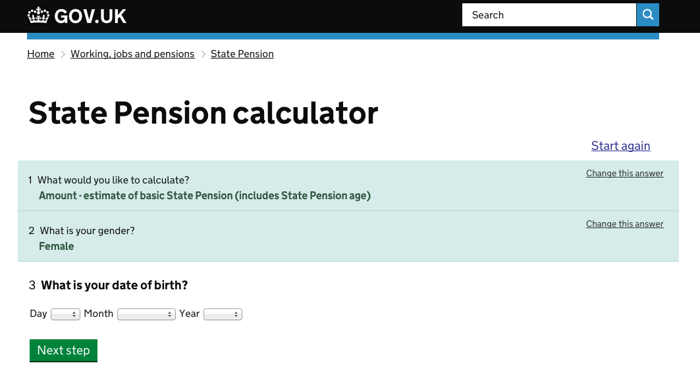
Smart Answer
Sarah
(ex)GDS
GDS
Paul
*
*

Slide 39
Content should be as short, simple and specific as possible
Sarah
(ex)GDS
GDS
Paul
*
*

Slide 40
Content should
define the audience
be ordered around what people need to know when
include enough information so the user can make a decision or take an action
Sarah
(ex)GDS
GDS
Paul
*
*

Slide 41
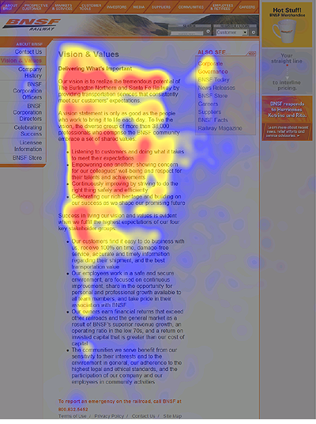
Sarah
(ex)GDS
GDS
Paul
*
*
Notes:
People don’t come to your site to read your content, they come do complete a task, get out, and get on with the rest of their day.
- This is from Nielsen Norman Group research, it shows how vital it is to provide key info up front.

Slide 42
Front-load sentences with the important stuff
If it’s not essential, leave it out
Break it up. Use
- short sentences and paragraphs
- subheads
- lists
- active voice
Sarah
(ex)GDS
GDS
Paul
*

Slide 43
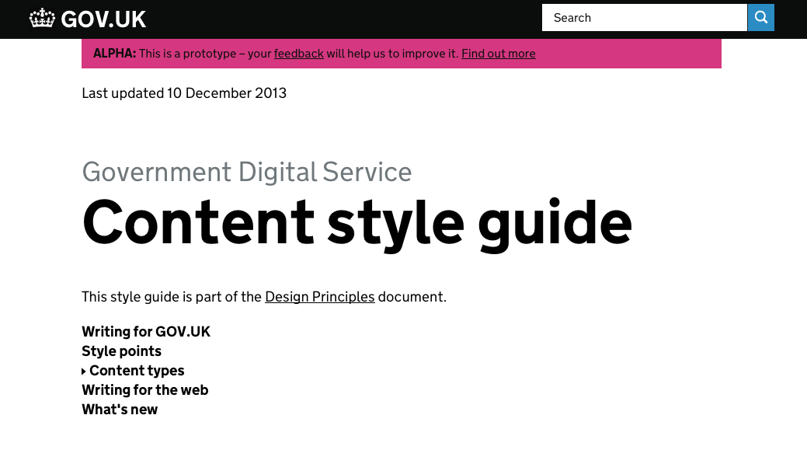
Sarah
(ex)GDS
GDS
Paul
*
*

Slide 44
“But it has to be complicated for
legal/policy reasons”
Not very often
Sarah
(ex)GDS
GDS
Paul
*
*

Slide 45
Write in the language used by real people
While taking account of language used by government
Sarah
(ex)GDS
GDS
Paul
*
*

Slide 46
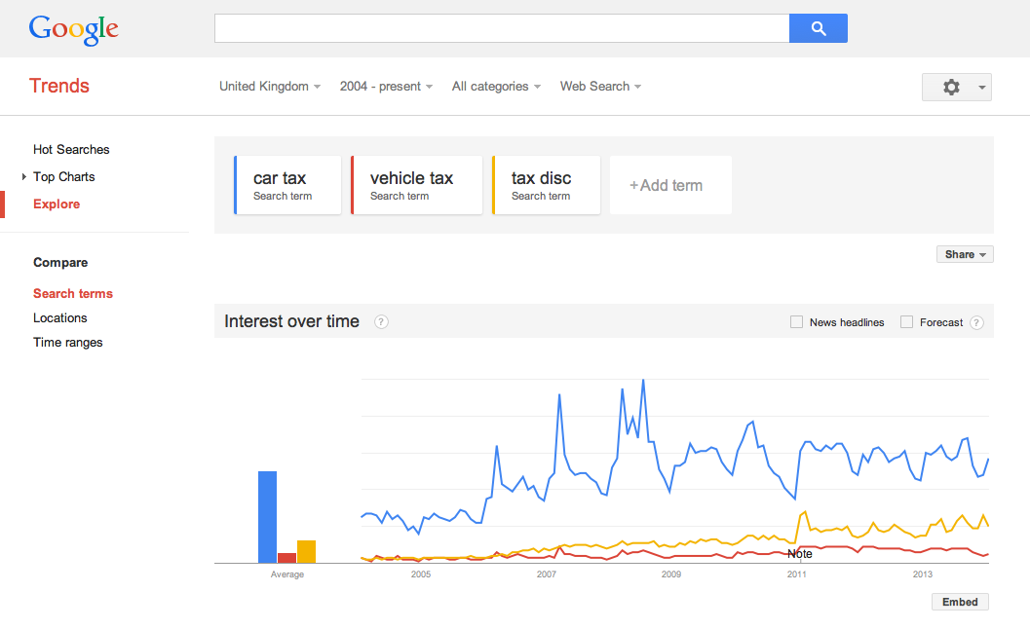
Sarah
(ex)GDS
GDS
Paul
*
*
Notes:
What language should you be using

Slide 47
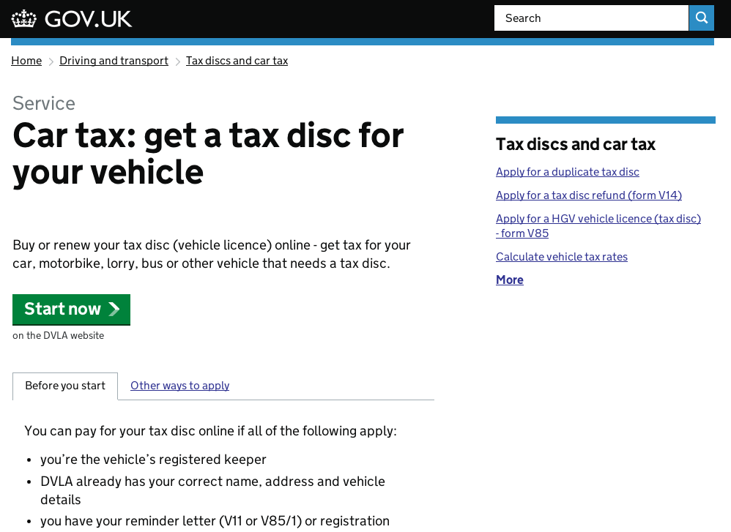
Sarah
(ex)GDS
GDS
Paul
*
*

Slide 48
Journeys
Sarah
(ex)GDS
GDS
Paul
*
*

Slide 49
Where is your user starting from?
What is their immediate need?
What are the previous/next steps they might need to take?
Sarah
(ex)GDS
GDS
Paul
*
*
Notes:
Every page is a landing page
Don’t assume the user is familiar with the layout/navigation of your site

Slide 50
Sarah
(ex)GDS
GDS
Paul
*
*
Notes:
Orientation at the top

Slide 51
Continuous improvement
Sarah
(ex)GDS
GDS
Paul
*
*

Slide 52
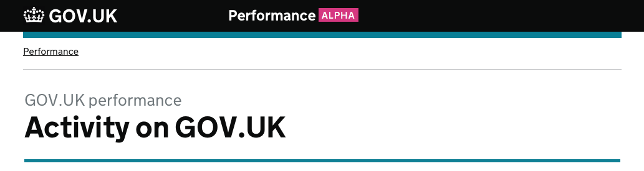
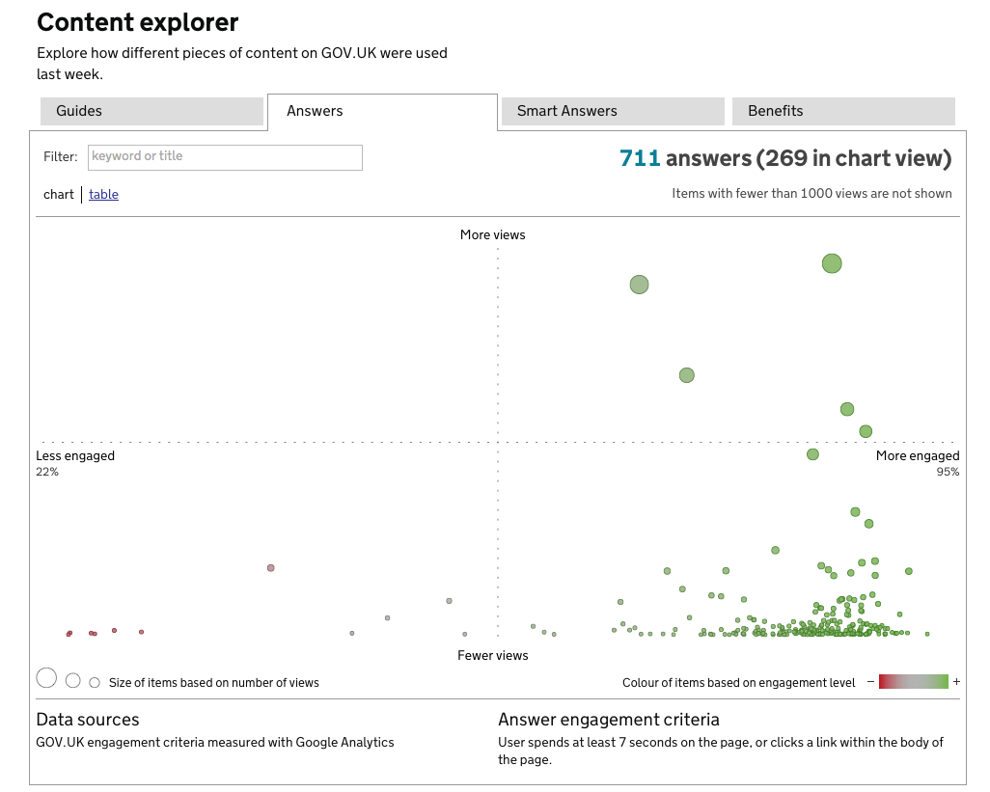
Sarah
(ex)GDS
GDS
Paul
*
*
Notes:
Bounce rate good to look at

Slide 53
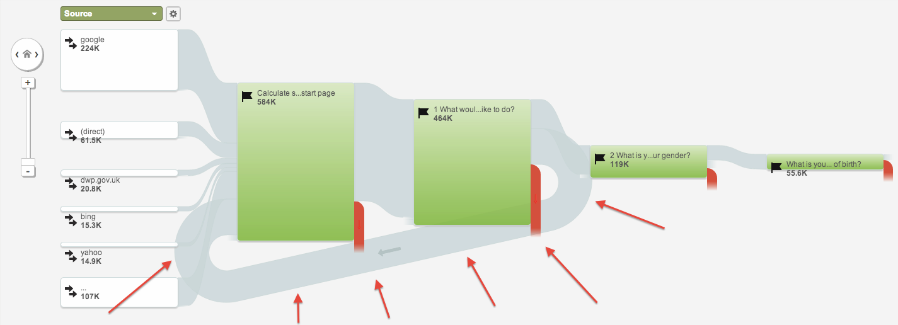
Steps through pension calculator
Sarah
(ex)GDS
GDS
Paul
*
*

Slide 54
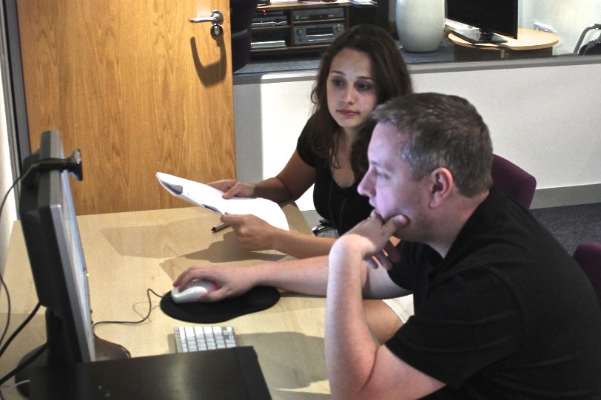
User research
Sarah
(ex)GDS
GDS
Paul
*

Slide 55
Start with user needs
based on evidence & data
design specific, simple content
signpost likely next steps
continuously monitor & improve
Sarah
(ex)GDS
GDS
Paul
*
*

Slide 56
Useful links
Google Trends
GOV.UK Style Guide
GDS Design Principles
GDS Blog
Sarah
(ex)GDS
GDS
Paul
*
*

Slide 57
Putting users first
The story of GOV.UK
Sarah Prag
@SarahPrag
Sarah.prag@gmail.com
(ex)GDS
Notes:
*

